Slide 1

Bicycle , clothing, accessories analysis of global Multi-Store Brand
By Chris White
Looking for market trends for business and marketing guidance.

Slide 2
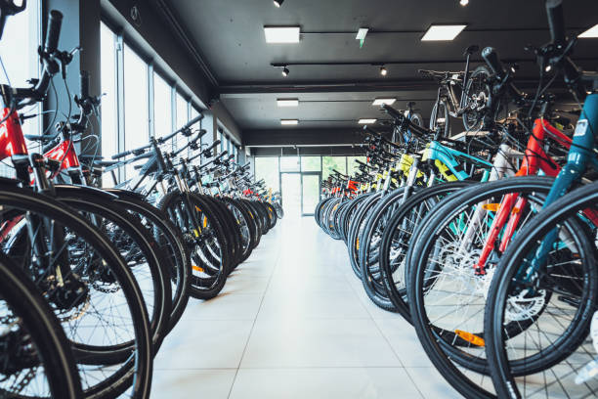
The data is 113,000 rows of history of sales across bicycle, accessory and clothing category sales.
DATA
Collected data from multiple stores represented in 6 countries across the world.
*Data source : Kaggle

Slide 3

And investigating which age group buys the most bikes per country.
OBJECTIVES
I’m analyzing what the correlations of revenue and profit between different counties and the product categories to see if theirs a trend.
Data Clean
Data Exploration
Data Preparation
Data Visuals
Data Review
Also looking for the most profitable sub-category per country.

Slide 4
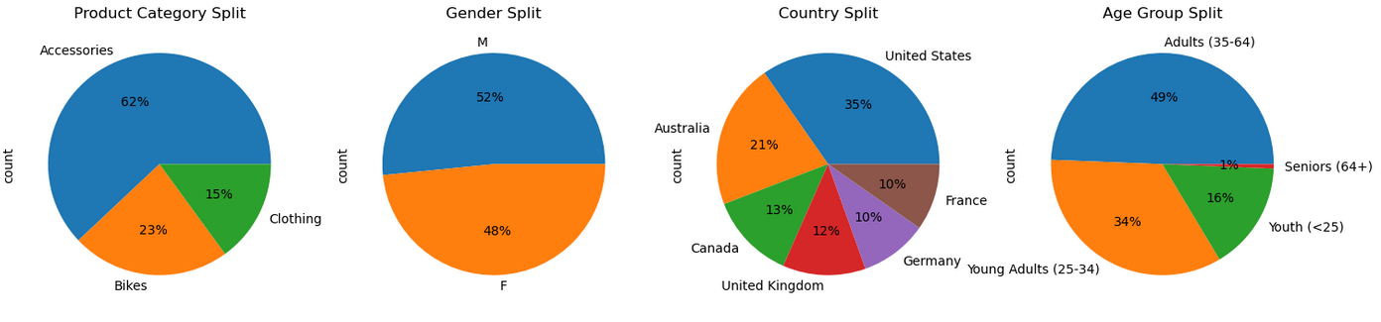
Overview of the company’s distribution
With these charts we can clearly see a high-level view of the distribution splits of the company’s metrics.

Slide 5
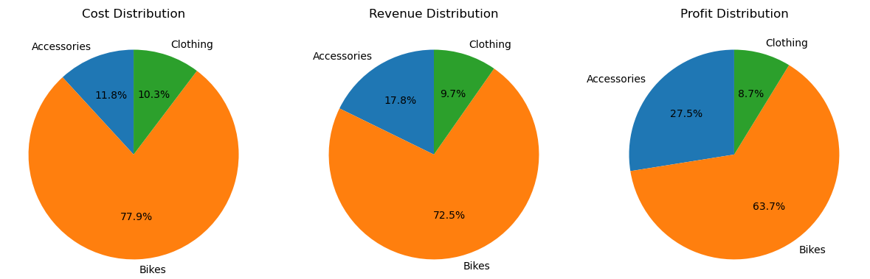
Overview of the Companies financial distribution
Here we can see a high-level view of the company’s financial distribution, with bikes being the clear financial lead.

Slide 6
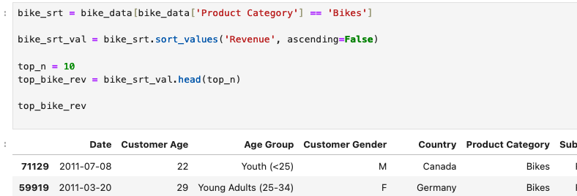
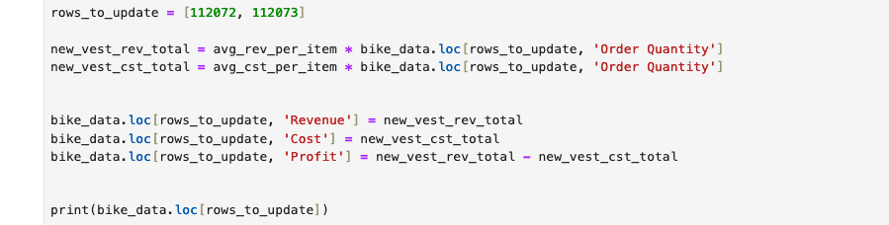
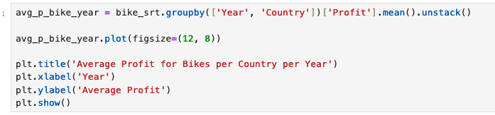
CLEANING AND FILTERING THE DATA
Looking through the data I wanted to clean the data, so it could show most accurate representation, work through our objectives.
The data that we have from the company is overall pretty good but did have some anomalies which needed to be dealt with.
With such a large data set I applied many filters and functions to get the results to enable to create clear visuals.

Slide 7
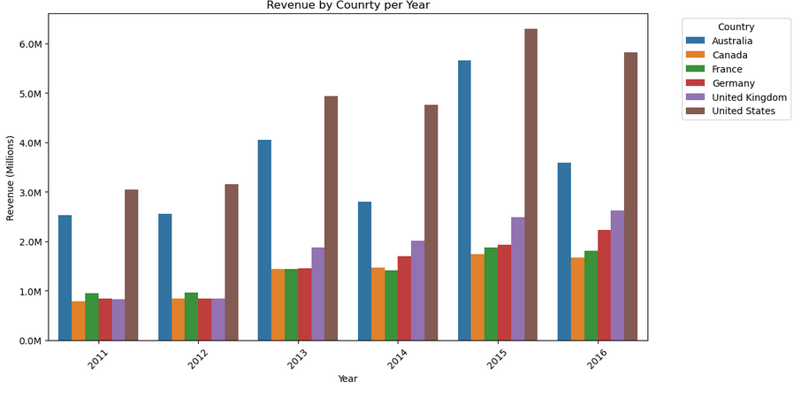
Company revenue results per year
The revenue trend shows the company going in the right direction.
There was a dip in 2014 and 2016 is only first half of the year.
US and Australia generate the most revenue.
The others similar in size and growth.

Slide 8
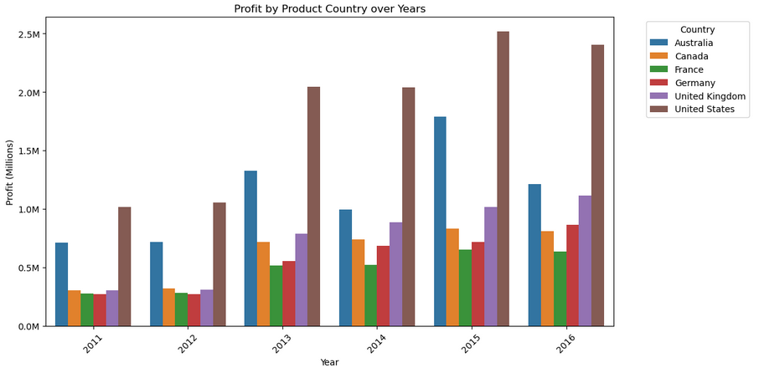
Company profit results per year
Again, the profit shows company growth.
There was less of a dip in 2014 profit, 2016 is only the first half of the year.
Australia is getting closer to US in profit in 2015.
France’s profit lagging behind others.

Slide 9
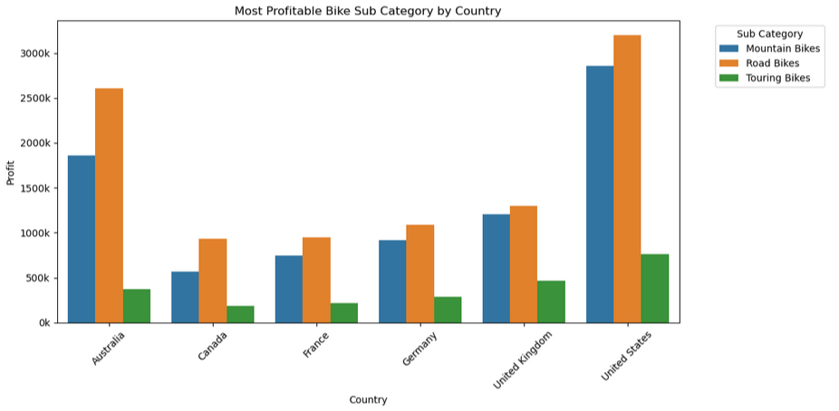
Company’s most profitable bikes results per country
Road bikes clearly has a dominance, but Mountain bikes are not far behind.
UK has similar Road & Mountain bike profit.
Can the UK increase its road bike profit to the similar splits to ither countries.

Slide 10
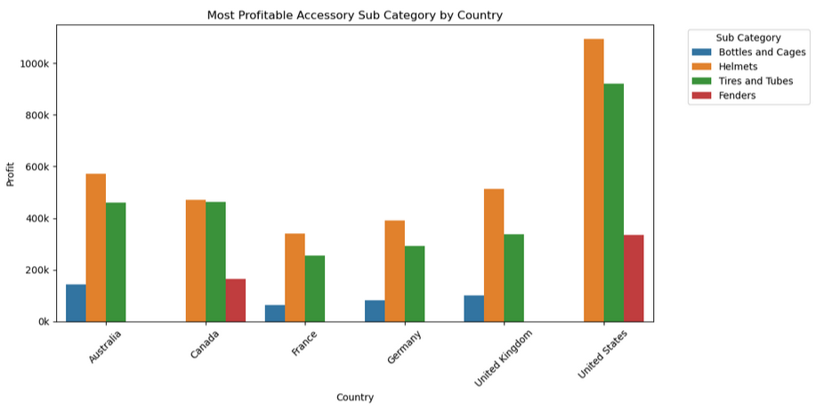
Company’s most profitable accessories by country
Helmets are the most profitable items across all countries.
Look into Fender sales in Europe and Australia as they don’t feature.
Bottle and cage profits in 4 countries similar to US Fender profits.
Could Canada be making more money on helmets?

Slide 11
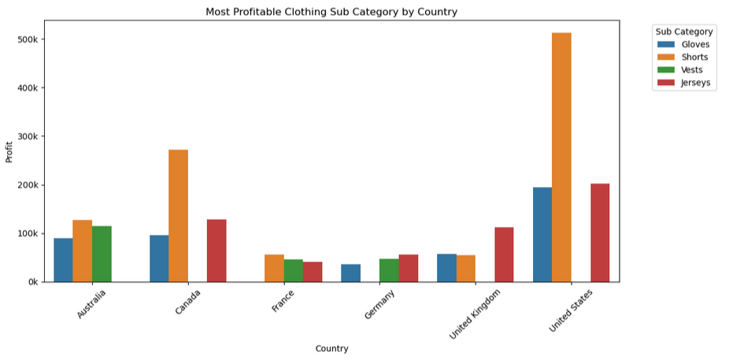
Company’s most profitable clothing by country
Shorts feature across the chart, with US Shorts being hugely profitable.
Vest profits decent in a few countries.
Is there a reason why Jersey profits don’t feature in Australia.
Can Short profit and sales be looked into for EU and Australia for improvement.

Slide 12
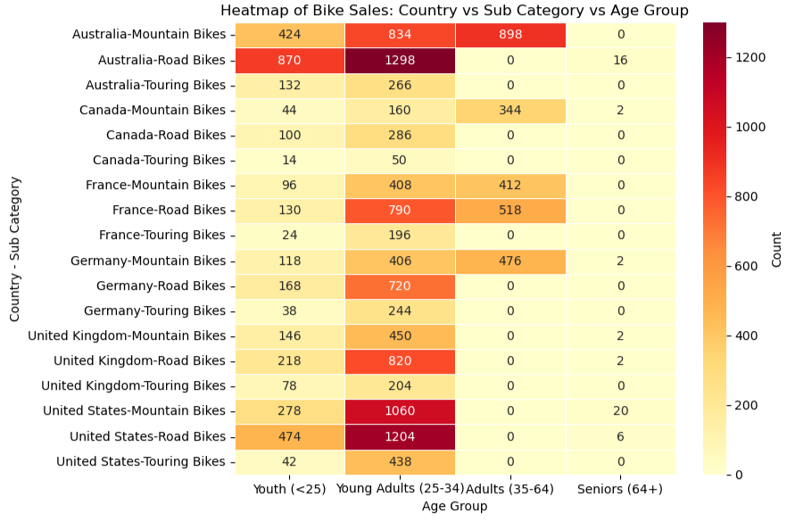
Company’s Age Group by Country Metrics
The Young Adults (25-34) globally buy the most bikes, all countries above 49.6% .
Road Bikes were the most popular with all countries except Canada that had overall split of 55% of Mountain Bike sales.
Senior (64+) represented less than 1% of sales in each country.
Touring Bikes made up on average 10.8% of sales across all countries, mainly purchased by Youth & Young Adults.

Slide 13
REVIEW

